Slide 1
FBLA Nationals
Computer Game and Simulation
Atlanta, Georgia
2023

Slide 2


Lost
By: Eric Ma

Slide 3
TABLE OF CONTENTS
Level Design
Programming
UI/UX
Game Play
Key Concepts and Story
Game Engine and Implementation
UI/UX Walkthrough
Game Features and User Immersion

Slide 4


01
Level Design
Key Concepts and Story

Slide 5
Key Concepts
Freedom
Visual Clarity
Optional Challenges for Hints
Multiple ways to complete a level
Distinctive Interactable Objects
Matching Aesthetics

Slide 6
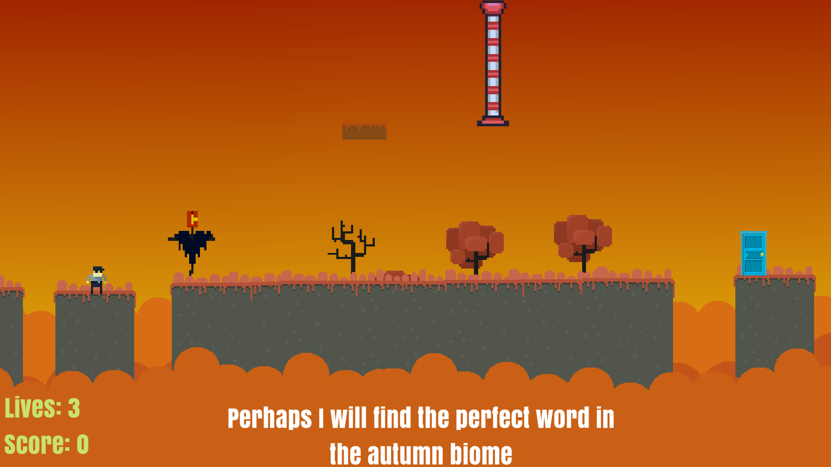
Key Concepts
Freedom
Optional Challenges for Hints
Multiple ways to complete a level

Slide 7
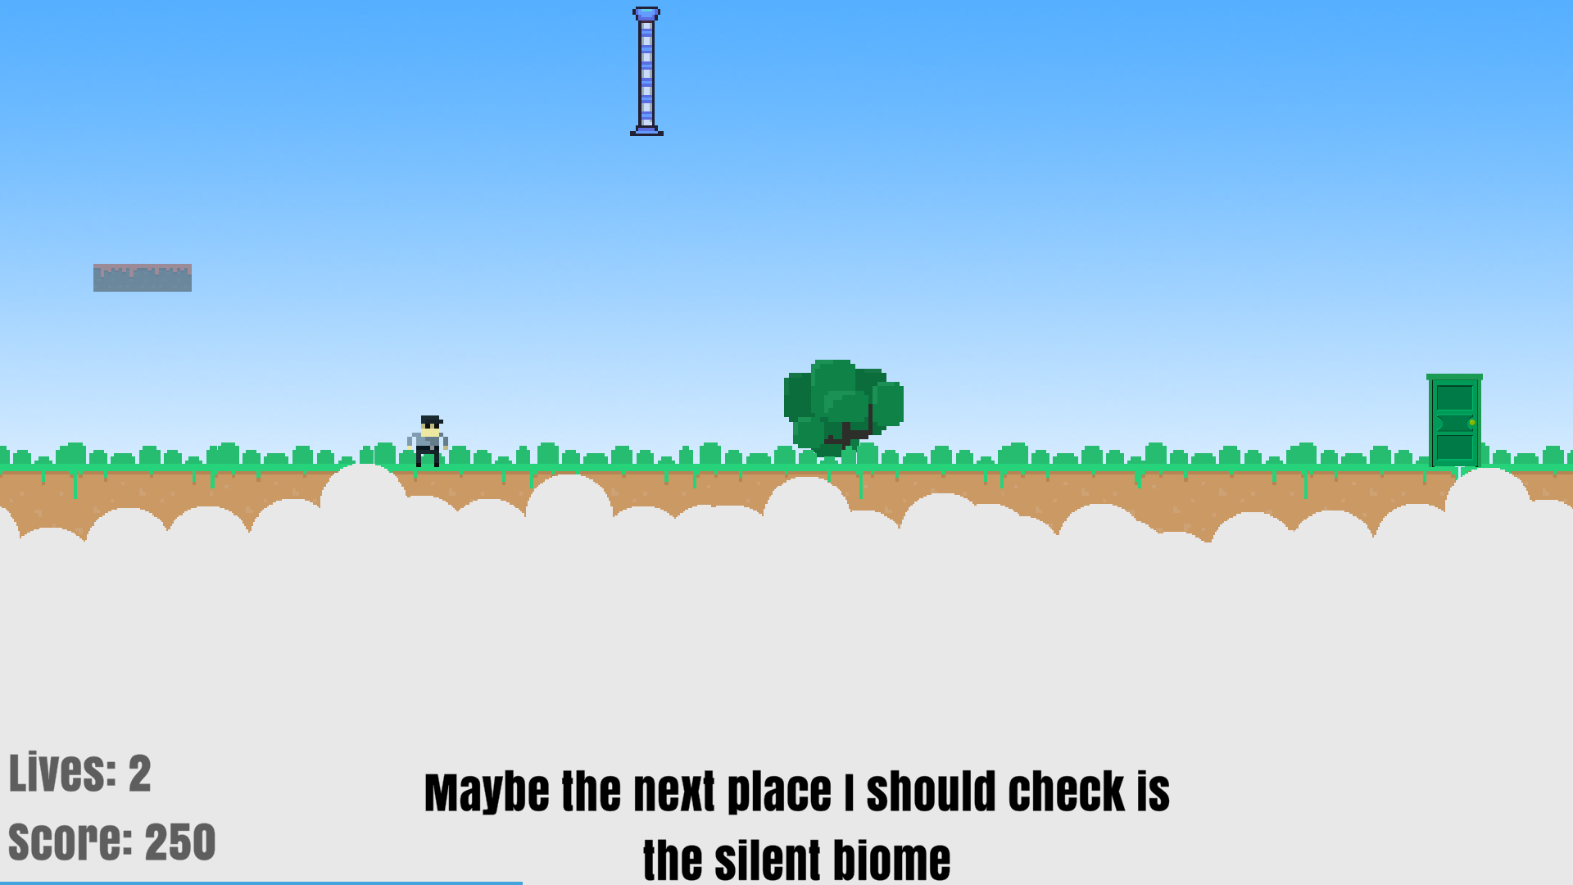
Key Concepts
Visual Clarity
Distinctive Interactable Objects
Matching Aesthetics

Slide 8
Story
Key Concepts
Self growth
Accepting imperfection
Deeper understanding of perfection

Slide 9
02
Programming
Game Engine and Implementation

Slide 10

Game Engine
Unity and C#
Python and PyGame
Prior Experience
Easy interaction of Code and Graphics
Many premade graphics
Large libraries and lots of documentation
Simple implementation

Slide 11
Animations
Code Snippet
Implementation

Slide 12
Puzzle Game
Code Snippet
Implementation

Slide 13
03
UI/UX
UI/UX Walkthrough

Slide 14
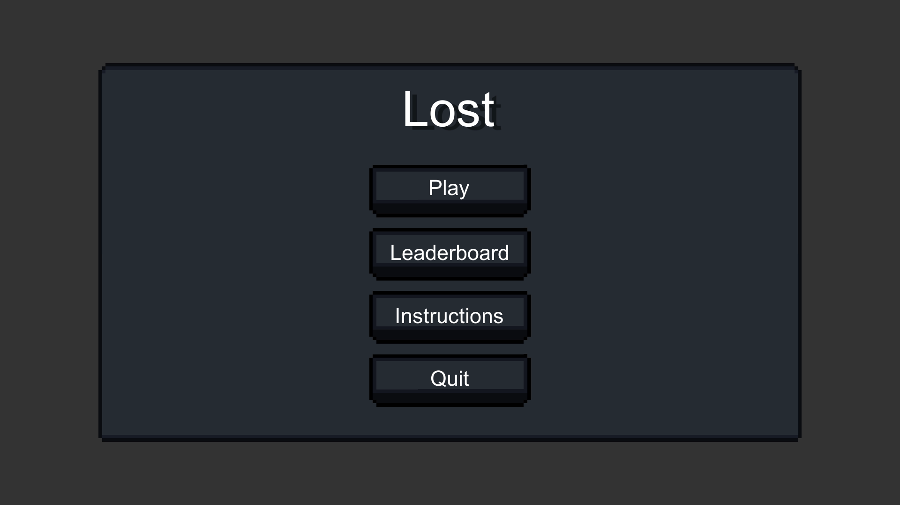
UI/UX Walkthrough

Slide 15
04
Game Play
Game Features and User Immersion

Slide 16
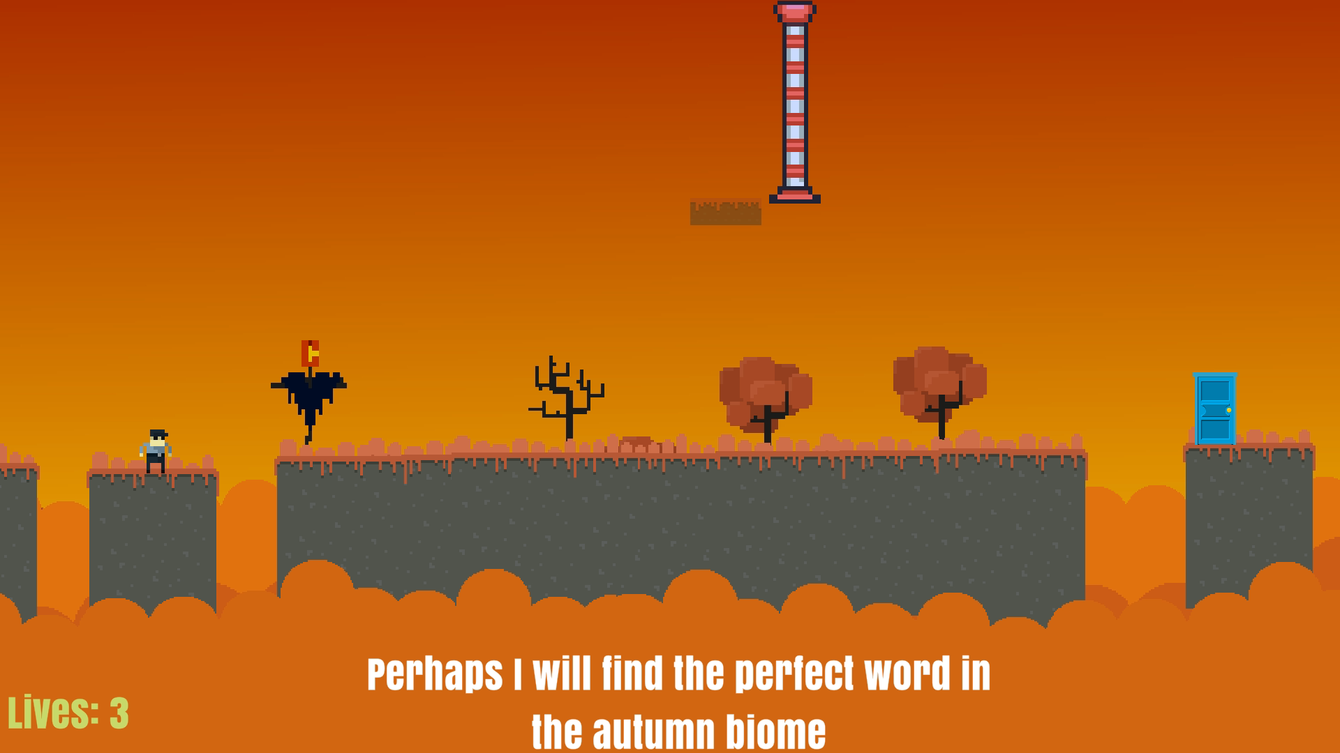
Game Features

Slide 17
User Immersion
Experience
Background Music
Animations
Endings
Defeat
Victory

Slide 18
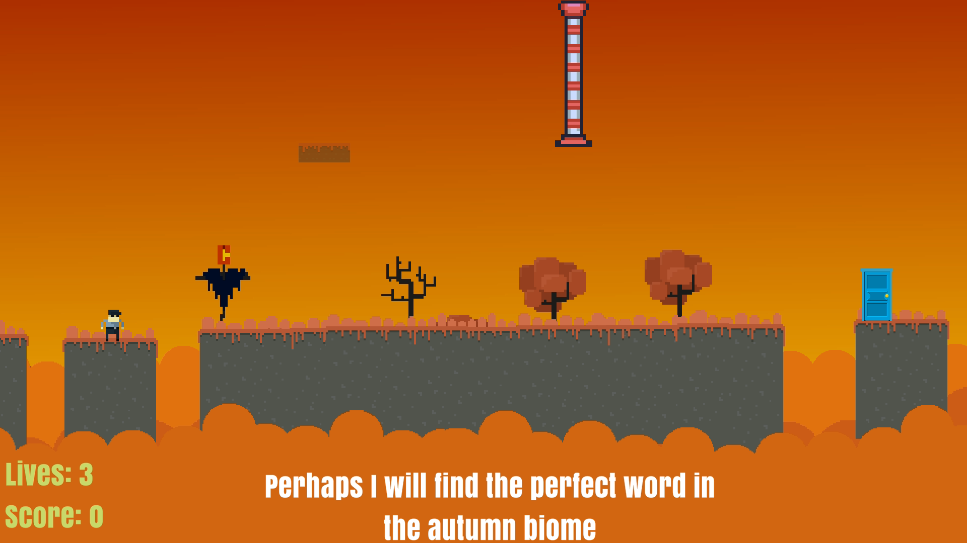
Game Over

Slide 19
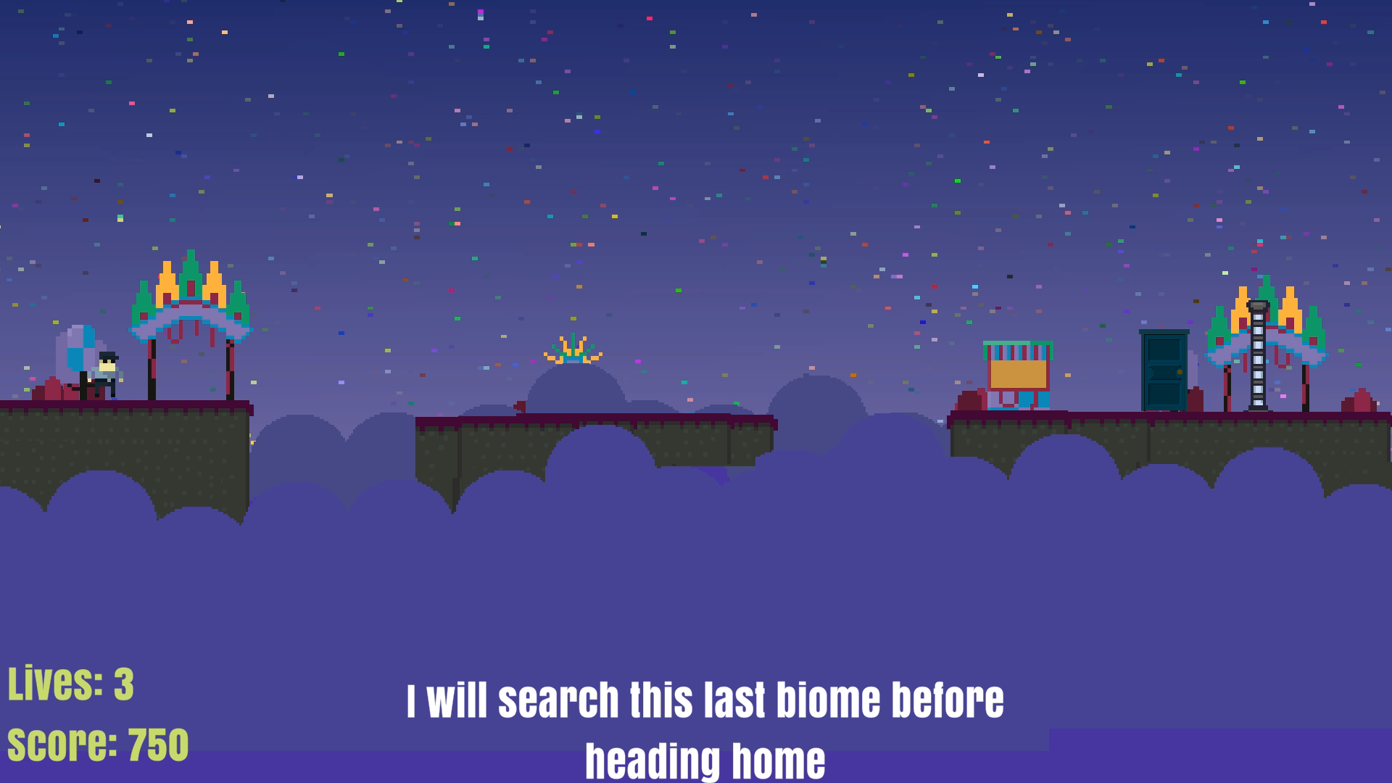
Victory Screen

Slide 20
THANKS!
Do you have any questions?
maeric567@gmail.com
Eric Ma from Middleton High School
608-209-4126

Slide 21


